Slide 1



SIGNATURE VARIFICATION
USING ANN
E/20/016 - Amarakeerthi H.K.K.G
E/20/055-De Silva H.D.S.
E/20/231-Madhura T.W.K.J.
E/20/404-Ukwaththa U.A.N.T.
01

Slide 2
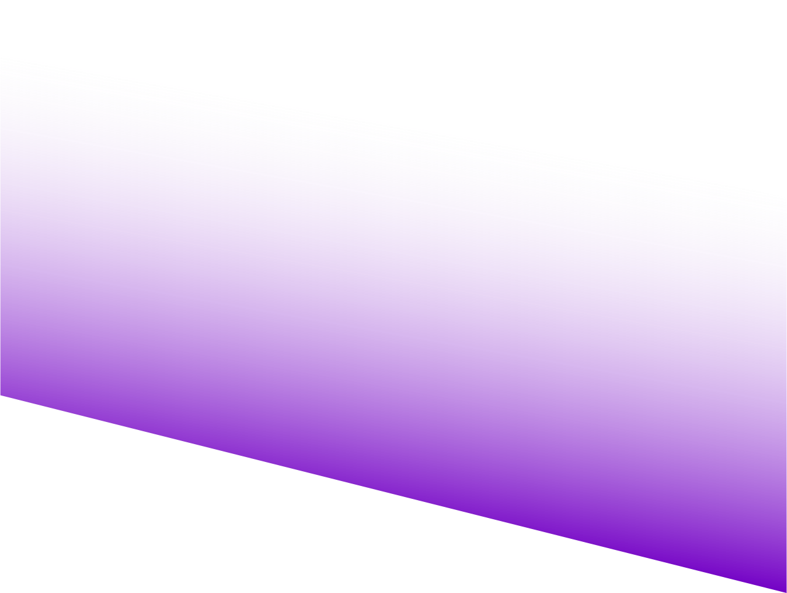
Introduction | 3
Motivation | 4
Real-World Relevance | 5
Siamese Network | 6
Architecture Overview & Structure | 7
Basic Architecture | 9
Data and Pre-processing | 10
Training Process | 11
Evaluation Metrics | 12
Reslts | 13
Challenges & Solutions | 14
Table
of
Contents
02

Slide 3

Introduction
What is Signature Verification?
A crucial process for authentication and security.
Used in banking, legal documentation, and identity verification.
Challenges in Traditional Methods
Manual verification is time-consuming and error-prone.
Rule-based algorithms may fail with variations in signatures.
03

Slide 4

Motivation
Power of Artificial Neural Networks (ANN)
Can learn complex signature patterns and detect fakes effectively
Growing security concerns
Increase in fake signatures and identity theft
Limitations of manual verification
Prone to human error, time-consuming, and inconsistent
04

Slide 5


Real-World Relevance
Legal & Government
Ensures authenticity in contracts and official documents
Banking & Finance
Prevents check fake and unauthorized transactions
Corporate & Employment
Verifies signatures in HR and business records.
05

Slide 6
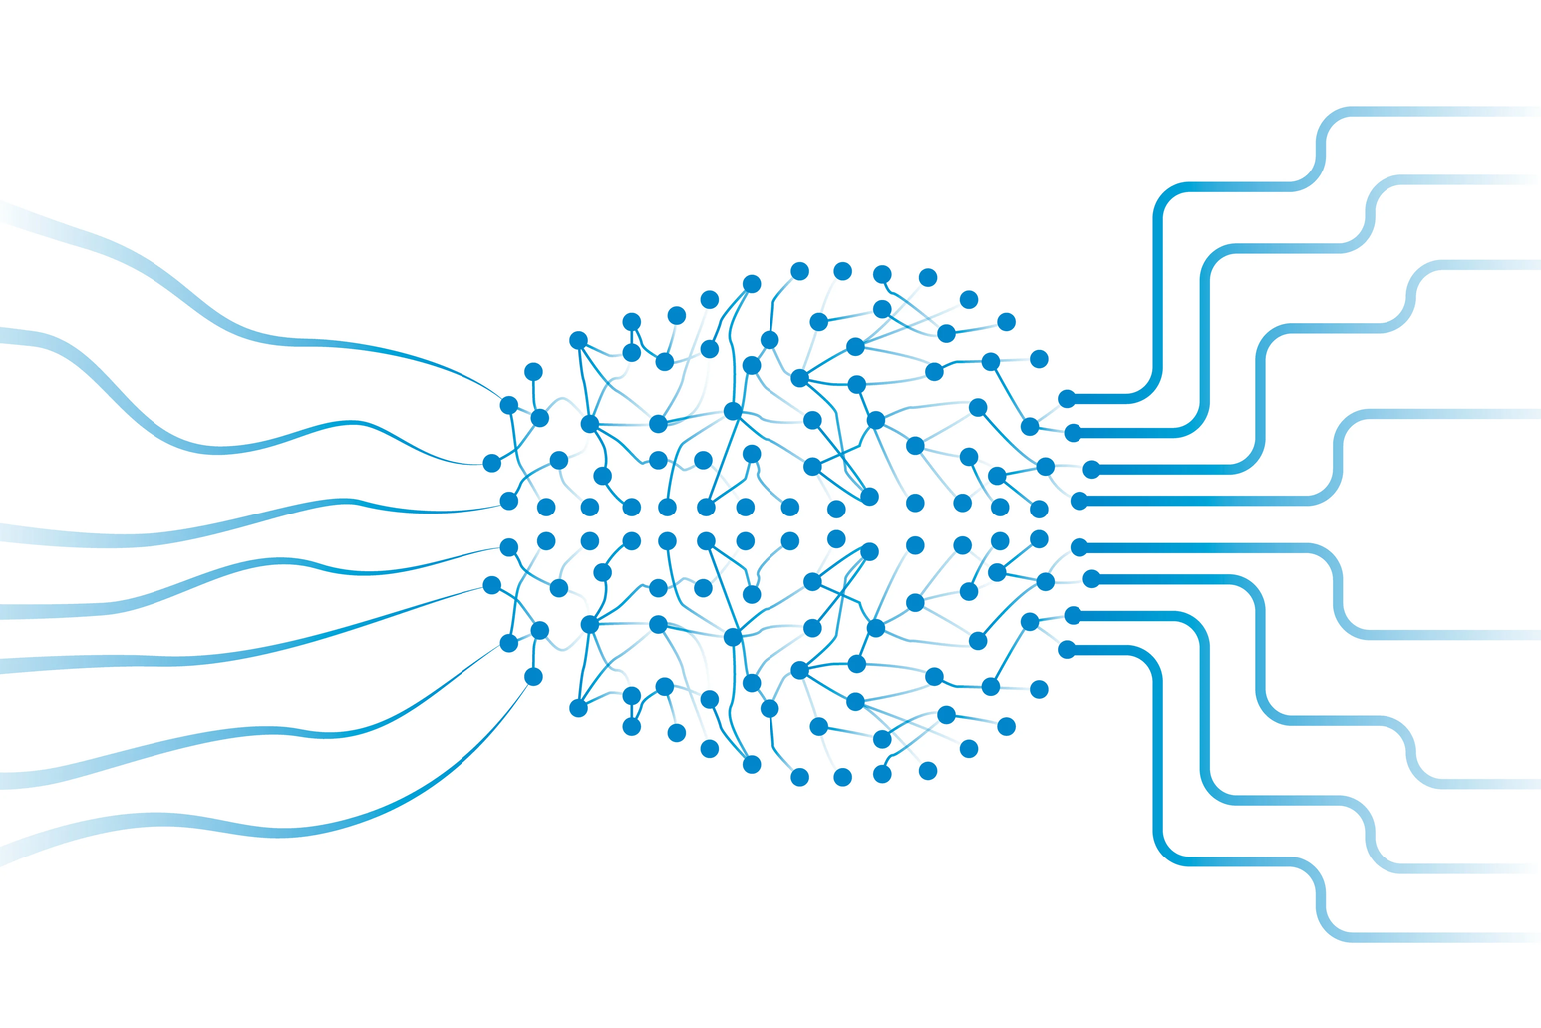
Siamese Network
Why Choose a Siamese Network?
Siamese networks are ideal for this, as they compare two inputs and determine their similarity.
Alternative Architectures Considered
CNN
RNN
06

Slide 7
Architecture Overview & Structure
Input Layers
Two inputs, one for each signature image.
Shape: (128, 128, 1) (grayscale images).
Embedding Model
Convolutional Layers
4 Conv2D layers with increasing filters: 64, 128, 256, 512.
ReLU to introduce non-linearity.
Pooling Layers
MaxPooling2D to reduce spatial dimensions after each convolution.
05
07

Slide 8
Architecture Overview & Structure
Distance Layer
Measures similarity between the two embeddings.
Used instead of concatenation, ensuring the model focuses on comparing features.
Fully Connected Layers
Dense layer with 64 neurons, ReLU activation.
Output layer
Sigmoid activation to classify as genuine or forged (binary output).
08

Slide 9
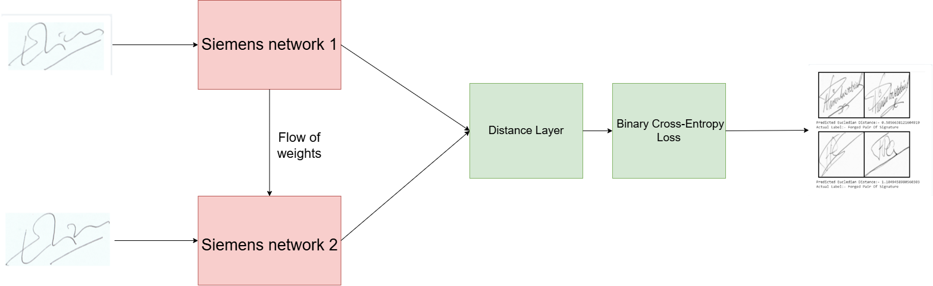
Basic Architecture
09

Slide 10
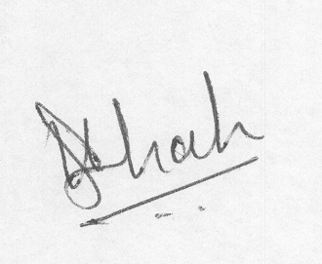
Dataset and Preprocessing
CEDAR Signature Dataset
Processing steps
Genuine signatures
Forged signatures
Image Loading
Grayscale Conversion
Resizing
Normalization
Pair Creation
Positive pairs
Negative pairs
Train-Test Split
10

Slide 11

Training Process
Hyperparameters
Optimizer: Adam
Activation Function: ReLU
Loss Function: Binary Cross-Entropy
Batch Size: 32
Epochs: 20
Overfitting Prevention Strategies
Early Stopping
Data Normalization
11

Slide 12
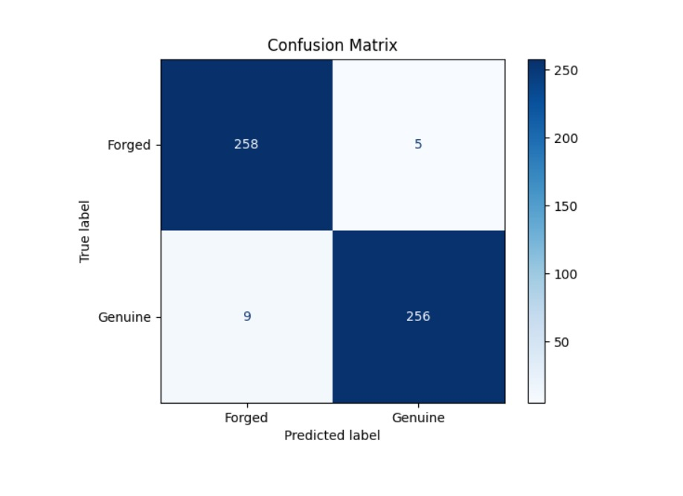

Evaluation Metrics
Accuracy
Precision
Recall
F1-Score
Confusion Matrix
12

Slide 13
Demonstration & Results
13

Slide 14
Challenges Solutions
Convolutional Layers with Small Filters
Using Conv2D layers with increasing filters (64 → 128 → 256 → 512) extracts hierarchical features.
Use better Max Pooling Layers
Use Kaggle for GPU acceleration
Overfitting
Handling High-Dimensional Data
Computational Resource Limitations
14

Slide 15
Thank you!

